Slide 1

The Roles Consultants Play
Understanding why you are there and deciding how to play the role
is essential for consulting success

Slide 2

Why are you there?
"Due diligence" is a large business for consultancies - providing an independent assessment of an investment opportunity.
How "independent" does the client want you to be?
How independent do you need to be (legally and ethically)?
Difficult questions to ask - important questions to answer, in a wide range of engagements.

Slide 3
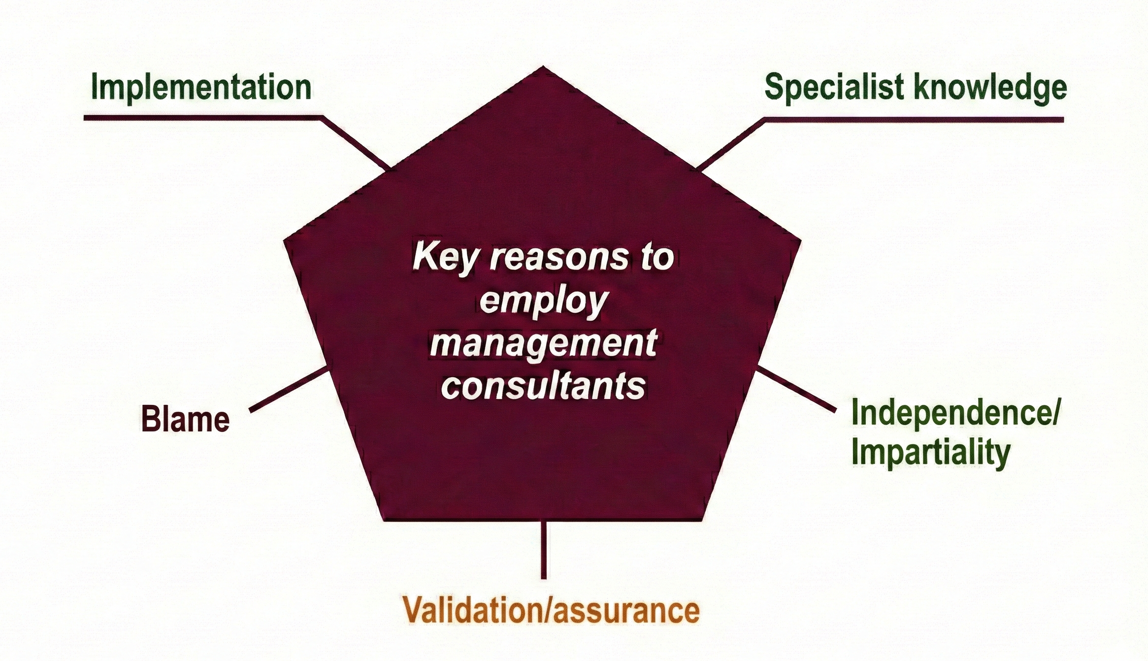
Why do clients hire consultants?
(Ringland & Shaukat, 2004)

Slide 4




Four Consultant Roles (Schein, 1987)
The Plumber
The Doctor
Fix the defined problem. They know precisely what's broken; you have the technical skills to repair it. Scope is clear, success is measurable.
Diagnose what's wrong. They sense something isn't right but can't pinpoint it. They trust your expertise to identify the underlying issue.
The Adviser
The Navigator
Help them think through options. You support their problem-solving process and provide frameworks, but they own the ultimate decision.
Guide through change. The strategic decision is made; your role is to help them execute it effectively and manage the journey.
In any engagement, you may move between these roles … but make sure you know which role you are in (and which you are interested in focusing on.

Slide 5



Surfacing the Hidden Brief - preview of contracting (next week)
"What would success look like?"
If they describe a highly specific outcome rather than a range of possible findings, they may want validation rather than open analysis.
"Who else has looked at this?"
If there have been internal debates, previous consultants, or competing analyses, you may be functioning as a tiebreaker …. or a scapegoat.
"What happens if the findings surprise you/us?"
This question tests whether they're genuinely open to
diagnosis and unexpected recommendations.

Slide 6


Internal Consultants Face Higher Stakes
The client is also a colleague:
power dynamics and personal relationships complicate boundaries
Political navigation is (even more) unavoidable: you must understand organisational dynamics whilst maintaining credibility
You can't (easily) walk away from a difficult engagement:
it affects relationships and career prospects
Your reputation follows you through the organisation:
one conflict/misstep can define how you're perceived for years
The same questions about role and motivation matter … but internal politics make them even harder to ask directly.
If you are/might be an internal consultant: look at Wright's (2009) research on professional identity.

Slide 7


Reflection: Your Experience
01
Recall a (difficult) engagement
Think about a consulting project you've experienced, either as consultant or client.
02
Identify the role
What role were consultants asked to play? Plumber, Doctor, Adviser, or Navigator?
03
Surface the need
What role did the client actually need? Was there a mismatch between expectation and reality?
04
Examine motivation
Did the client's stated reason for hiring match the real motivation driving the engagement?
Review the written material, including Wright's research on internal consultant identity dynamics.
COMING UP NEXT (AND LASTLY)
Why academic researchers are sometimes sceptical about consultancy, and why that scepticism can make consultants better at the job.

